Slide 1



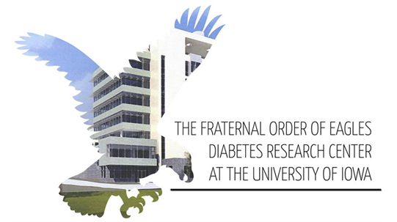
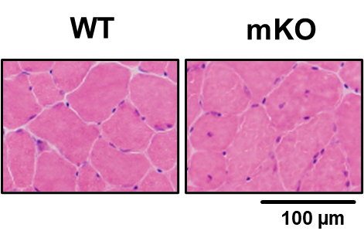
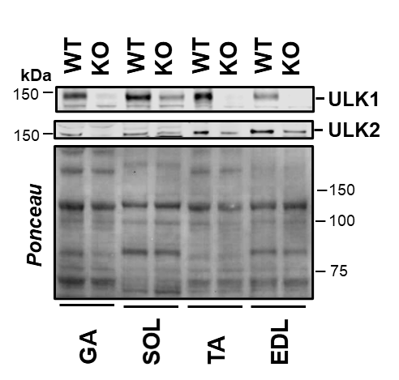
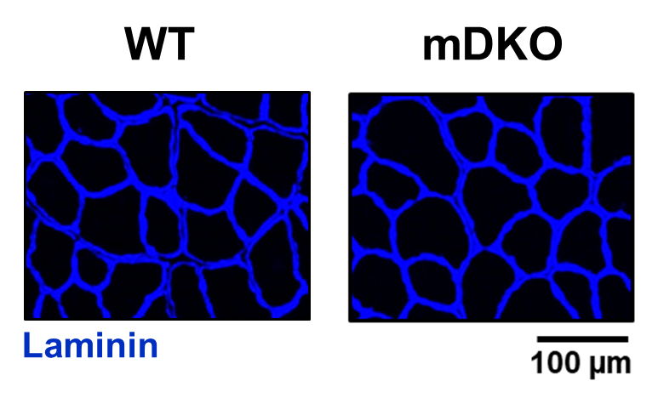
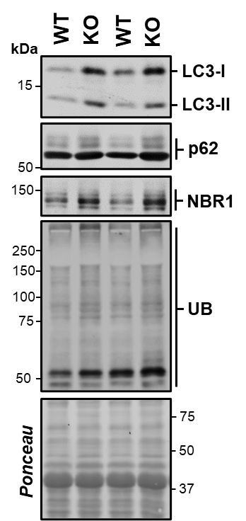
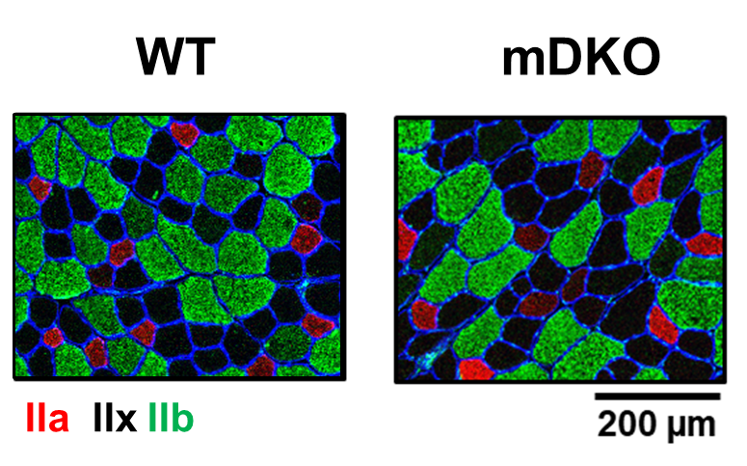
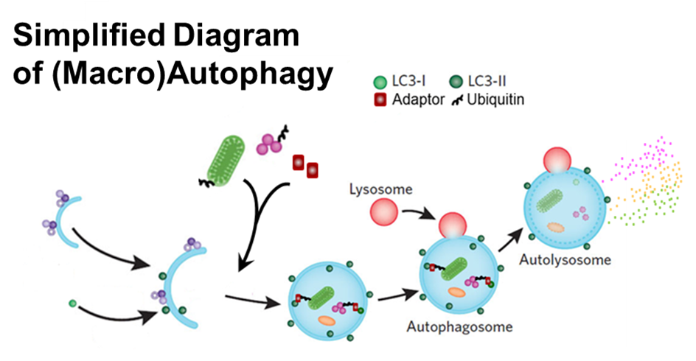
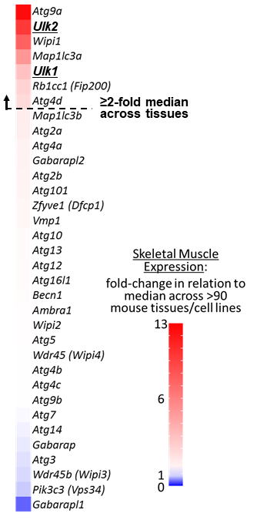
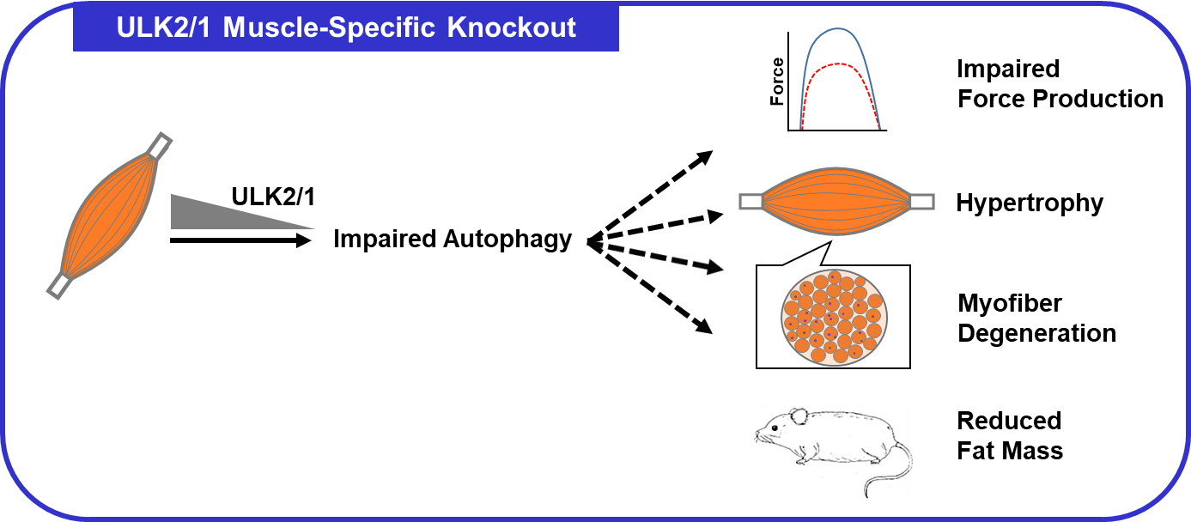
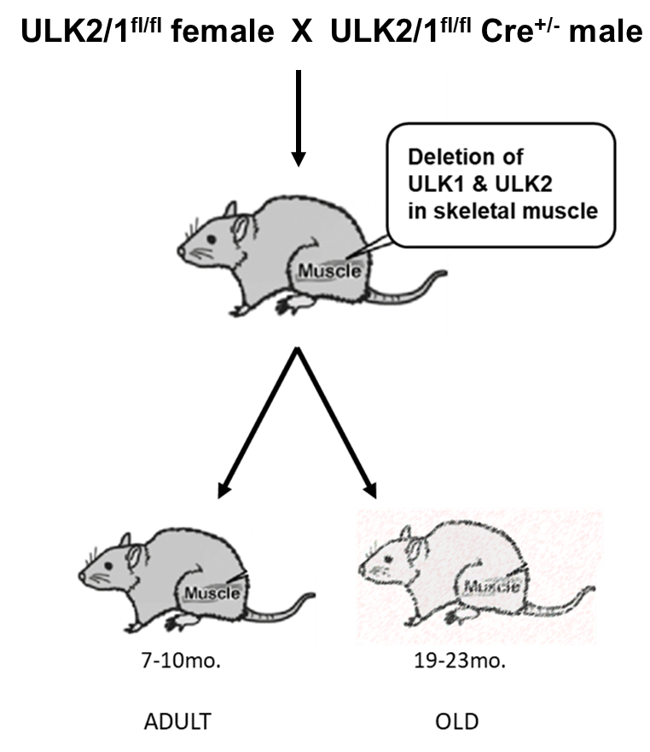
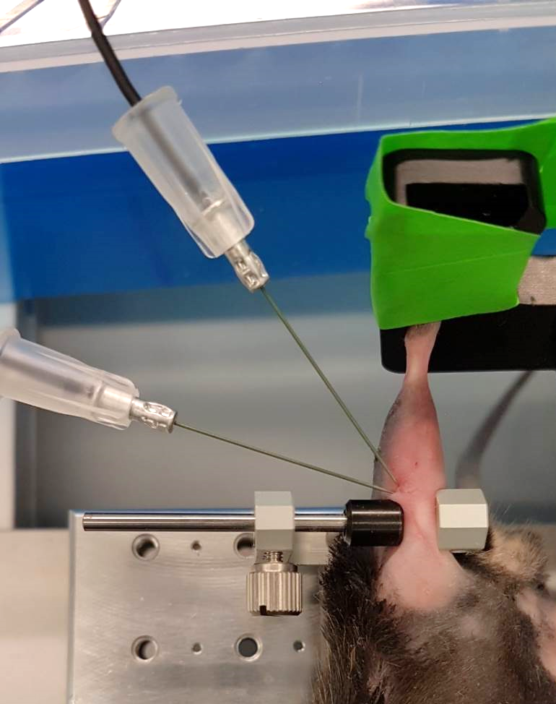


Skeletal Muscle ULK1 and ULK2 Are Essential for Maintenance of Muscle Quality
Jordan D. Fuqua, Julia Hughes, Dylan Kuennen, Matthew Harris, Kristen Turner, Ana Kronemberger,
L. Gustavo Sousa, Sue Bodine, Vitor A. Lira
Departments of Health & Human Physiology and Internal Medicine, Obesity Research and Education Initiative, Fraternal Order of Eagles Diabetes Research Center, Abboud Cardiovascular Research Center, Pappajohn Biomedical Institute, University of Iowa, Iowa City, IA.
Abstract
Results
Fig. 4: Myofibers are enlarged in ULK2/1 mDKO mice. (N=4-7, data are means ± SEM; *P<0.05).
Fig. 5 (Continued):
Maintenance of skeletal muscle quality is a major concern during a variety of metabolic and myopathic disorders and other conditions associated with unloading, as seen in space travel and aging. Due to the long-lived nature and expression of a high number of large cytoskeletal proteins, which are prone to misfolding and aggregation, skeletal muscle fibers are under a constant proteotoxic challenge. Therefore, appropriate protein degradation and turnover is essential for maintaining skeletal muscle health. Autophagy is a catabolic recycling process and is the primary means of degrading large and aggregate proteins. We have recently discovered that two putative autophagy kinases, ULK1 and ULK2 are enriched in skeletal muscle. In fact, skeletal muscle expresses both ULK1 and ULK2 at high levels (i.e., >2-fold the median expression of 91 mouse tissues and cell lines) suggesting an important, yet unknown role for their combined elevated expression in muscle. Therefore, to investigate the joint role of ULK1 and ULK2 on muscle homeostasis we generated mice with skeletal muscle-specific double knockout of these genes (ULK2/1 mDKO). Here, we demonstrate that ULK2/1 mDKO mice have larger muscles (10-30%) that are actually weaker (i.e., with decreases of 12% in absolute force and 19-22% in relative force) in comparison with wild type littermates. Additionally, ULK2/1 mDKO mice are leaner (23-35% less fat). Mechanistically, loss of ULK 2/1 impairs skeletal muscle autophagy as indicated by accumulation of LC3, p62, NBR1, and ubiquitinated proteins. These results identify a previously unknown role for ULK2 and ULK1 in coupling muscle mass and strength. However, further investigation is necessary to understand the precise molecular events involved.
Fig. 1: Muscles are deficient of ULK1 and ULK2 in ULK2/1 mDKO mice. mRNA normalized to GAPDH mRNA. Gastrocnemius (GA), Soleus (SOL), Tibialis Anterior (TA), Extensor Digitorum Longus (EDL). (N=4-6 data are means ± SEM; **p<0.01, ****p<0.0001).
Fig. 6: ULK2/1 mDKO mice are learner. (N=7-11, data are means ± SEM; *p<0.05, **p<0.01).
Objective
Fig. 2: Autophagy is impaired in ULK2/1 mDKO mice. (N=3-4, data are means ± SEM; *P<0.05, **p<0.01, ***p<0.001, ****p<0.0001).
Identify the joint role of ULK1 and ULK2 in regulating skeletal muscle homeostasis and contractile function via a skeletal muscle-specific knockout mouse of these genes (ULK2/1 mDKO).
Background & Study Design
Fig. 5: ULK2/1 mDKO mice have reduced max force and increased number of myofibers undergoing degenerating/regenerating cycles (i.e., centrally located nuclei). Gastrocnemius (GA) (N=4-11, data are means ± SEM; *P<0.05, ***p<0.001, ****p<0.0001).
Conclusions
ULK2/1^{fl/fl}
myogenin-Cre^{+/-}
Relative to GA mass
X
Fig. 3: Muscle mass is increased in ULK2/1 mDKO mice. Gastrocnemius (GA), Soleus (SOL), Tibialis Anterior (TA), Extensor Digitorum Longus (EDL). (N=4-9, data are means ± SEM; *P<0.05, **p<0.01, ***p<0.001, ****p<0.0001).
ULK2/1^{fl/fl}
Adult
Old
ULK2/1^{fl/fl} = WT
ULK2/1^{fl/fl} MYO= mDKO
In vivo analysis of muscle contractile function (maximal isometric contraction of ankle plantar-flexors)
Relative to GA mass
This work is funded by: AHA 16SDG30360001 (V.A.L.).
Iowa Space Grant Consortium under NASA Award No. NNX16AL88H
Contact Information: vitor-lira@uiowa.edu
Fuqua et al., 2019. FASEB J
Notes:
http://www.biologycorner.com/resources/rat_circ_artery.gif

